Slide 1
Project 2
File Organization
And
Controlling a digital pin (to control an LED)
This lecture is under Project 2

Slide 2
Goals this week
Create proper files for organizing our C code
Learn how to
  Create a new project and copy files.
  Set up the definitions.h file for global text substitution
    This is for readability and code clarity
  Define (or set up) pins
  Write microfunctions for turning lights on and off
  Write a loop to turn lights on and off in main.c

Slide 3
How we will organize our code - or what is
The meaning of files we will create
main.c
Initialize the system
definitions.h
#define directives to
create “alias” words
Function prototypes
microFunctions.c
Very small functions
Call RobotOS or testSuite
TestSuite.c
Test hardware functions.
robotOS.c
The robot commands go here
“Macro functions” – more complex usage of microfunctions
Single action
These create a toolkit and increase reliability

Slide 4
A few programming “tips” if “tips” mean “do it this way to make Prof. Smith happy. ☺”
All variable names use camelCase
All variable names are nouns and are good names for how the variable name is used:
  Example:
  myPin7 = 1; // what does this mean?
  greenLED = ON; // That’s pretty clear!
All functions look like verbs. They describe the action to be taken or accomplished by the function
  Example:
  runRobotOS();
  turnGreenLedOn();
  stopAllMotors();

Slide 5
Programming Style Requirements
(Continued)
Use the definitions.h file
  Define string substitutions
  Define *ALL* functions with new function prototypes
Use the “compiler directive” “#define” → “#define ON 1”
  A warning about this… this is a string substitution.
    This is not a “C” or “C++” command
    Don’t put a semicolon at the end!
Example: When your code is compiled, every place the compiler sees “greenLED”, it will replace that string with the string “digOutput7”.
  #define greenLED digOutput7
What will happen if you put a semicolon like this?
  #define greenLED digOutput7;
  Then if your code contained this command:
  greenLED = ON;
  Your compiler would change this to:
  digInput7; = ON; // ← See the extra unwanted semicolon?
Note that this can be ‘layered’.

Slide 6
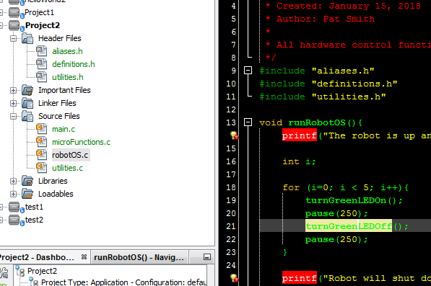
Creating a new project
Follow the directions from last week to create a new project
Close *ALL* open files you are editing to avoid accidentally editing files from a previous project without realizing you aren’t editing the current project’s files.
Use Windows File Explorer to copy files from previous project folder into the new project folder
Add new existing files (the ones in the new project folder) to this project
  Make sure you’re adding from the new project’s folder. MPLAB X IDE defaults to the previous project’s folder.
  Add “.h” header files to header section
  Add “.c” C files to source files section
Build your project before you do anything to test it!
Close *ALL* open files you are editing to avoid accidentally editing files from a previous project without realizing you aren’t editing the current project’s files.

Slide 7
How to control a pin? – First, select one!
See the programming guide for available pins. This chart is in that guide.
Pin Number | Pin Name/Function | Pin Name/Function | Pin Number
1 | MCLR: for programming and reset | AVDD | 28
2 | B0 | AVSS | 27
3 | B1: Test Switch | B6 | 26
4 | B2: Test Switch | B7 | 25
5 | B3 | B8 | 24
6 | B4 | B9 | 23
7 | B5 | F4 | 22
8 | VSS | F5 | 21
9 | OSC: external oscillator | VDD | 20
10 | C15 | VSS | 19
11 | T2CK: Timer Clock | RX: UART | 18
12 | T1CK: Timer Clock | TX: UART | 17
13 | VDD | F6 | 16
14 | D9 | D8 | 15

Slide 8
How to control an output Pin
What name will you give this pin to describe its function?
  Today you are adding pins to control LED’s.
  Please use something like “greenLED” for the pin name in definitions.h
Is it digital or analog?
  DIGITAL (0 or 1, high or low)
Is it input or output?
  Output – You’re outputting a high or low voltage level to control the LED
Then, assuming you are going to use pin 7 to control a green LED then put the following in your definitions.h file
#define greenLED digOutput7
See next slide for example…

Slide 9
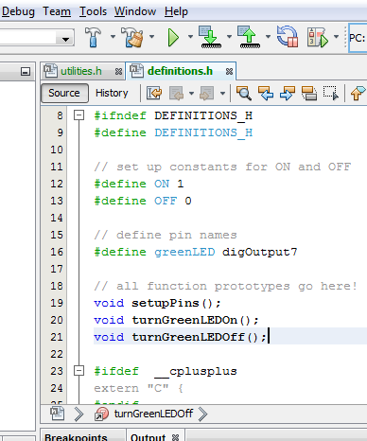
Set up the pin
Add definitions, prototypes to “definitions.h”
  Define values for “ON”, “OFF”
  Define name for green LED pin
    Name it greenLED
    Use the pin name from the alias header file
  Add function prototypes for the setupPins function and for the functions controlling the LED.

Slide 10
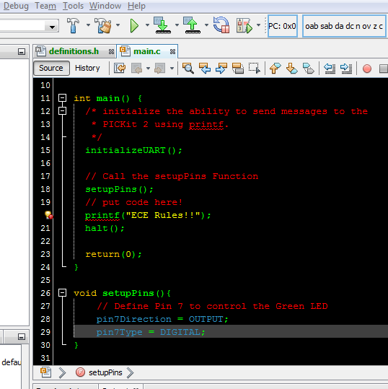
Set up the pin
Add the call to setupPins() function in main() (main.c)
  Place it below initializeUart()
In setupPins refer to “Pin7”
  Define it as “OUTPUT”
  Use caps, case matters
  Define it as “DIGITAL”

Slide 11
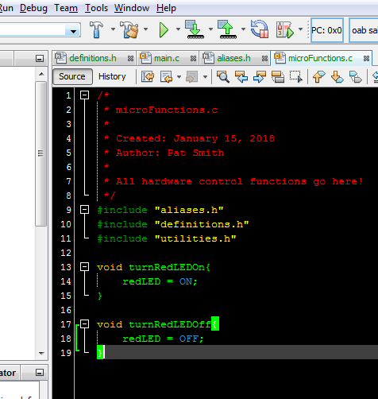
Create the microfunctions.c file
First, we need to:
  #include “definitions.h”
  #include “aliases.h”
  #include “utilities.h”
This is where we control the green LED pin
We called it greenLED in definitions.h
We need a microfunction to turn it off, and turn it on.
Two functions (see them at the right)
  “void turnGreenLEDon()”
  “void turnGreenLEDOff()”
  -- note: These are verbs!
Now we have to go back and add these to the definitions.h file.
Now we can make the RobotOS.c file

Slide 12
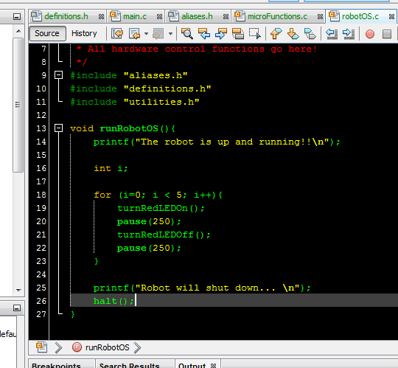
robotOS.c File creation
Create a file called “robotOS.c”
Add the include lines so it knows about definitions and aliases
Add the “runRobotOS()” function.
Go back and add this to definitions.h
Write runRobotOS() function
  First tell the user the Robot is running.
  Declare variables
    You can’t declare them dynamically in old “c” like you’re used to. Sometimes it will work, often it won’t.
  Set up a simple for loop
    Use your microfunction to turn the led on, wait, turn it off, and wait.
  Then tell the use the robot is shutting down and halt.

Slide 13
Checklist
Create a new project – Project 2 this week.
Use Windows File Explorer to copy files from the project 1 folder to project 2.
Download and import definitions.h file
  Add all function prototypes. For example: “void setupPins();
  Add all “constants”. Example: “#define greenLED digOutput7”
Add “setupPins()” to the main() function in the main.c file
  Add the function prototype to definitions.h (“void setupPins();” in definitions.h)
  In the function “setupPins()” define the chosen pins as digital, and output for each of the LED’s
Create “microfunctions.c” file – This is where the hardware control functions go.
  Add 4 functions to turn on and off the green and red LED.
  Don’t forget to add the prototypes to definitions.h – each function has a prototype!
Create “robotOS.c” file.
  Add the function “runRobotOS()” here
    This code contains the work to turn on and turn off LED’s. This is a simple loop!
  Add the function prototype for “runRobotOS()” to the definitions.h file.
Modify main() in the main.c file
  Add a call to setupPins()
  Add a call to runRobotOS()
Save everything!!
Now you’re ready to test it all!

